Slide 1
Year 10 PreATAR Science
Cyclone formation

Slide 2
Review
What is a cyclone?
Are cyclones formed with low pressure or high pressure systems?
Do cyclones spin clockwise or anticlockwise?
Are hurricanes the same as cyclones? How are they the same and how are they different?
In what ways do cyclones cause damage?

Slide 3
Learning Intentions
Global systems, including the carbon cycle, rely on interactions involving the biosphere, lithosphere, hydrosphere and atmosphere

Slide 4
Success criteria
Describe the formation of cyclones in the tropics.
Explain the effect of uneven heating of the Earth, convection currents, and The Coreolis Effect
Distinguish between cyclones, hurricanes and tornados
Explain why climate change is causing more extreme weather events.

Slide 5
What is a cylone?
A severe low pressure system, which spins clockwise, with damaging winds, rain and often storm surges.
They are associated with tropical coastal areas.

Slide 6
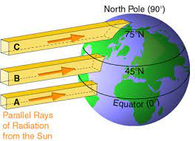
How do cyclones form?
The angle of the earth towards the sun causes light to be most intense over the equator and less intense over the poles.
The equator is hottest and the poles are coldest.

Slide 7
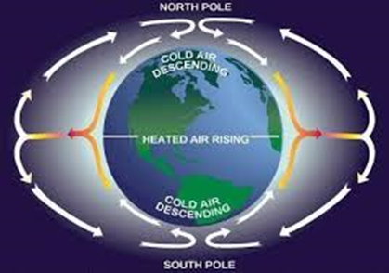
How do cyclones form
Hot, humid air rises at the equator
Cold, dry air falls at the poles creating a convection current.

Slide 8
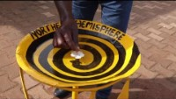
Why do cyclones spin clockwise?

Slide 9
The Coriolis Effect
Coriolis Effect

Slide 10
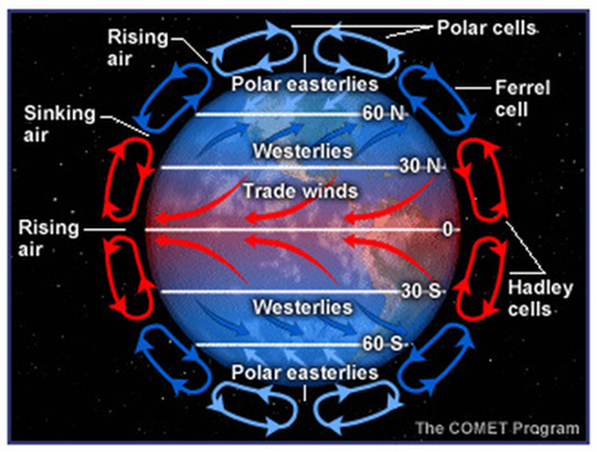

Slide 11
Worksheet - Cyclones
13a
13b

Slide 12
Success criteria
Describe the formation of cyclones in the tropics.
Explain the effect of uneven heating of the Earth, convection currents, and The Coreolis Effect
Distinguish between cyclones, hurricanes and tornados
Explain why climate change is causing more extreme weather events.

